Slide 1
Module 2: Problem Solving based on Searching

Slide 2
Problem Solving based on Searching
Uninformed Search Methods
Uniform Cost Search,
Breadth First Search,
Depth First Search,
Depth limited search,
Iterative deepening depth-first
Informed Search Methods
Best First Search,
A* Search

Slide 3
Introduction to Problem Solving by searching Methods
A goal-based agent is an AI system designed to achieve a specific goal.
One kind of goal-based agent called a problem-solving agent.
Problem-solving agents use atomic representations, that is, states of the world are considered as wholes, with no internal structure visible to the problem solving algorithms

Slide 4
Introduction to Problem Solving by searching Methods
Problem solving begins with precise definitions of problems and their solutions and give several examples to illustrate these definitions.
We then describe several general-purpose search algorithms that can be used to solve these problems
We will see several uninformed search algorithms—algorithms that are given no information about the problem other than its definition
Informed search algorithms, can do quite well given some guidance on where to look for solutions

Slide 5
Introduction to Problem Solving by searching Methods
Goal formulation, based on the current situation and the agent’s performance measure, is the first step in problem solving.
The process of looking for a sequence of actions that reaches the goal is called search.
A search algorithm takes a problem as input and returns a solution in the form of an action sequence.
Once a solution is found, the actions it recommends can be carried out. This is called the execution phase.
A simple “formulate, search, execute” design for the agent, as shown in Figure 1

Slide 6
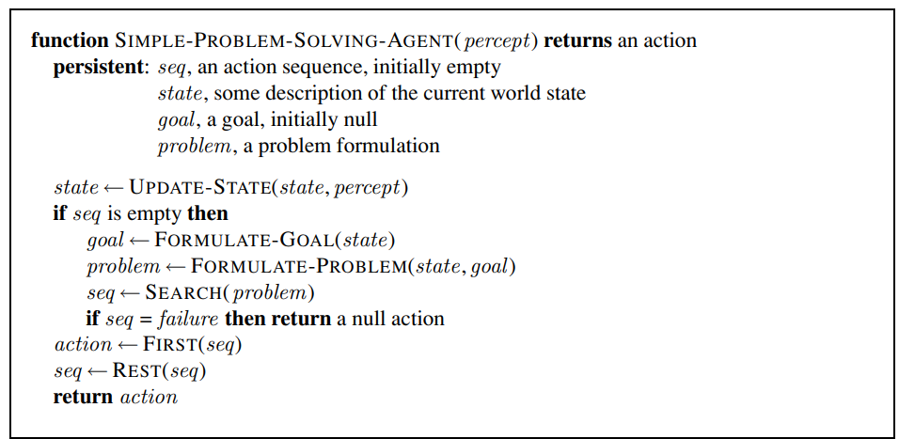
Introduction to Problem Solving by searching Methods
Figure 1 A simple problem-solving agent.

Slide 7
Introduction to Problem Solving by searching Methods
After formulating a goal and a problem to solve, the agent calls a search procedure to solve it.
It then uses the solution to guide its actions, doing whatever the solution recommends as the next thing to do—typically,
the first action of the sequence—and
then removing that step from the sequence.
Once the solution has been executed, the agent will formulate a new goal.

Slide 8
Introduction to Problem Solving by searching Methods
Well-defined problems and solutions
A problem can be defined formally by five components:
1. The initial state that the agent starts in.
Given a particular state s, ACTIONS(s) returns the set of actions that can be executed in s.
We say that each of these actions is applicable in s.
For example, the initial state for our agent in Romania might be described as In(Arad).
2. A description of the possible actions available to the agent.
For example, from the state In(Arad), the applicable actions are {Go(Sibiu), Go(Timisoara), Go(Zerind)}.

Slide 9
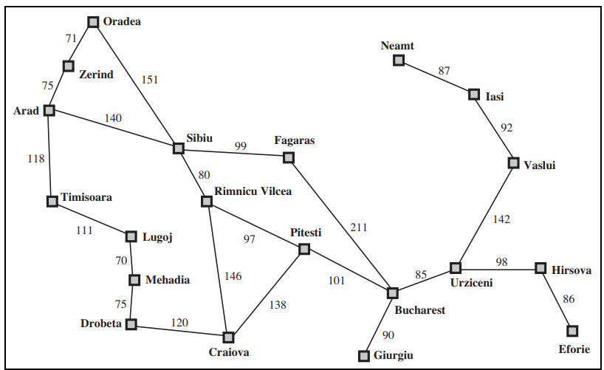
Simplified road map of part of Romania
Figure 2: A simplified road map of part of Romania

Slide 10
Introduction to Problem Solving by searching Methods
Well-defined problems and solutions
3. A description of what each action does;
the formal name for this is the transition model, specified by a function RESULT(s, a) that returns the state that results from doing action a in state s.
use the term successor to refer to any state reachable from a given state by a single action.
For example,
RESULT(In(Arad),Go(Zerind)) = In(Zerind) .

Slide 11
Introduction to Problem Solving by searching Methods
Well-defined problems and solutions
Initial state + actions + transition model = state space of the problem
the set of all states reachable from the initial state by any sequence of actions.
The state space forms a directed network or graph
A path in the state space is a sequence of states connected by a sequence of actions

Slide 12
Introduction to Problem Solving by searching Methods
Well-defined problems and solutions
4. The goal test, which determines whether a given state is a goal state.
The agent’s goal in Romania is the singleton set {In(Bucharest)}.
5. A path cost function that assigns a numeric cost to each path.
The problem-solving agent chooses a cost function that reflects its own performance measure
Solution quality is measured by the path cost function, and an optimal solution has the lowest path cost among all solutions.

Slide 13
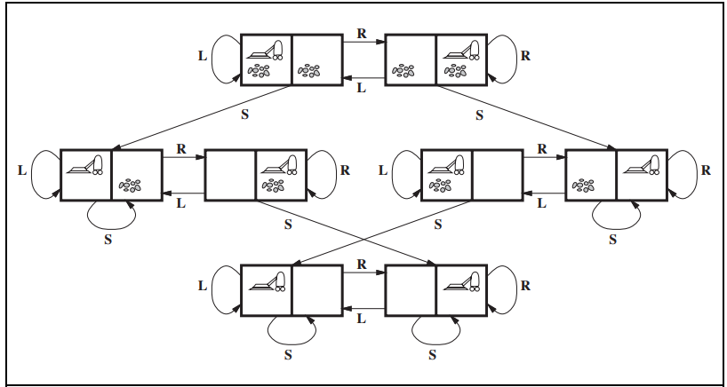
Real-world problem: Toy problems
The first example we examine is the vacuum world
Figure 3 The state space for the vacuum world. Links denote actions: L = Left,
R= Right, S= Suck

Slide 14
Real-world problem: Toy problems
States: The state is determined by both the agent location and the dirt locations.
The agent is in one of two locations, each of which might or might not contain dirt.
Thus, there are 2 × 2^2 = 8 possible world states.
A larger environment with n locations has n · 2^n states
Initial state:
Any state can be designated as the initial state.
2. Actions:
In this simple environment, each state has just three actions: Left, Right, and Suck. Larger environments might also include Up and Down

Slide 15
Real-world problem: Toy problems
3. Transition model:
The actions have their expected effects, except that moving Left in the leftmost square, moving Right in the rightmost square, and Sucking in a clean square have no effect.
4. Goal test:
This checks whether all the squares are clean.
5. Path cost:
Each step costs 1, so the path cost is the number of steps in the path

Slide 16
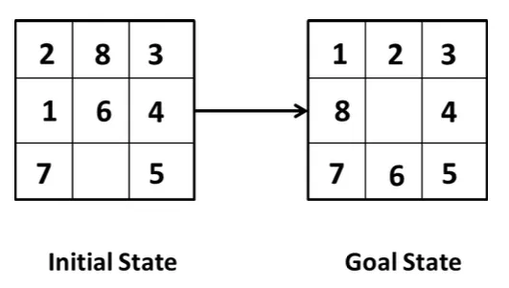
Real-world problem: 8-Puzzle

Slide 17
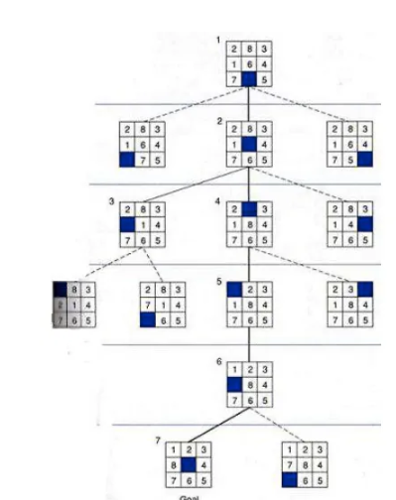
Real-world problem: 8-Puzzle

Slide 18
Real-world problem: 8-Puzzle
States: A state description specifies the location of each of the eight tiles and the blank in one of the nine squares.
Initial state: Any state can be designated as the initial state. Note that any given goal can be reached from exactly half of the possible initial states
Actions: The simplest formulation defines the actions as movements of the blank space Left, Right, Up, or Down. Different subsets of these are possible depending on where the blank is.
Transition model: Given a state and action, this returns the resulting state; for example, if we apply Left to the start state in Figure, the resulting state has the 5 and the blank switched.
Goal test: This checks whether the state matches the goal configuration shown in Figure. (Other goal configurations are possible.)
Path cost: Each step costs 1, so the path cost is the number of steps in the path.

Slide 19
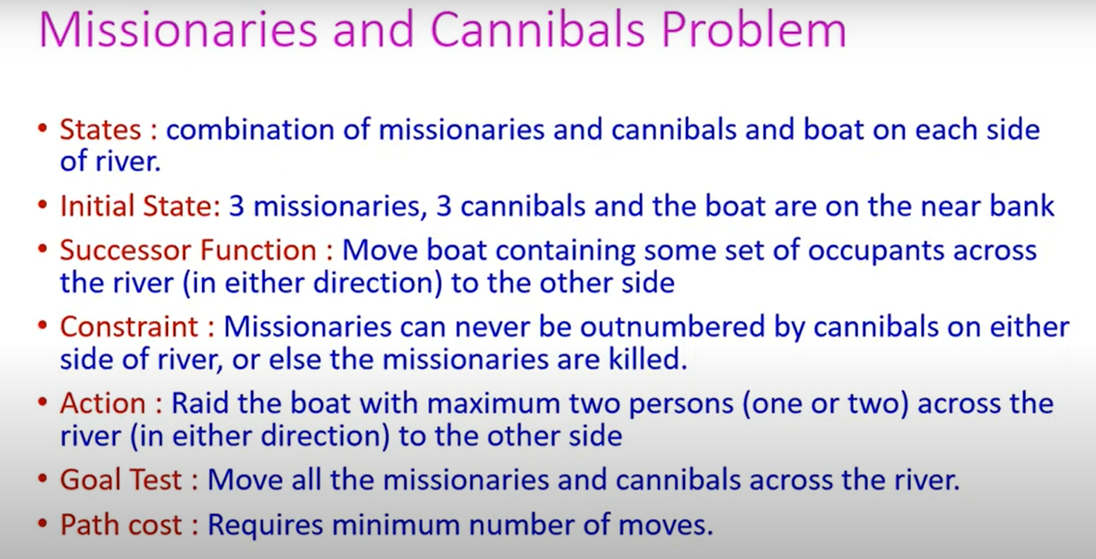
https://www.youtube.com/watch?v=uyuhcNdb7DI

Slide 20
